Slide 1
Office 365 Development
October 2014

Slide 2

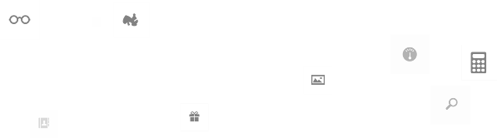
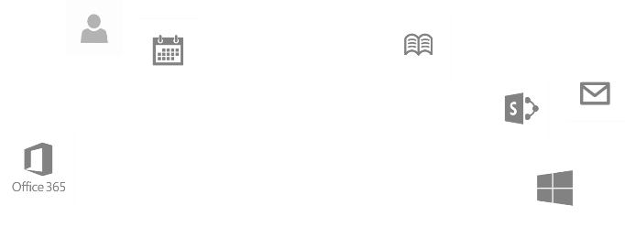
Recap
Introduction to Office 365 development
Module 1: Introduction to Office 365 development
Module 2: Getting started with Apps for Office
Module 3: Getting started with Apps for SharePoint
Module 4: Moving Full Trust Code to the Cloud Using Repeatable Patterns and Best Practices
Module 5: Getting started with the Office 365 APIs
dev.office.com/training

Slide 3
Course Agenda
Deep Dive into Integrating Office 365 APIs with Web Applications
Module 1: Deep Dive into Azure AD with the Office 365 APIs
Module 2: Deep Dive into Office 365 APIs for Calendar, Mail, and Contacts
Module 3: Deep Dive into Office 365 APIs for OneDrive for Business
Module 4: Deep Dive into Office 365 APIs for SharePoint Site services
Module 5: Deep Dive into Office 365 APIs for Yammer services
Module 6: Deep Dive into Office 365 APIs for Office Graph
Module 7: Deep Dive into Office 365 APIs for OneNote services

Slide 4
Deep Dive into the Office 365 APIs for OneNote Services
Speaker
Speaker

Slide 5

Agenda
Introduction
OneNote API Scenarios
Get Started with the OneNote service
Deep Dive into the OneNote service

Slide 6
Introduction

Slide 7
OneNote API Vision
Fast, simple, available anywhere
RESTful. Built on OData, JSON and HTML
CRUD API for Notes
CRUD API for Common entity types (Recipes, Movies, Books, Restaurants, Tasks, …)
Find anything quickly
Entity recognition, image processing, schematized content, and tags
Full text search and structured queries
Your digital memory store in the cloud
One place for all your memories. Never forget anything again.
Evoke your ideas whenever you need them with natural language search
Enable more personalized devices, apps, and smarter digital assistants
Notes:
This slide presents the overall vision for the OneNote product/service

Slide 8
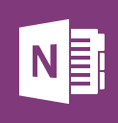
Pre-installed on every new Windows Device
Free on all platforms
Windows 8.1
Windows Phone
Mac
iOS
Android
And on the web with OneNote Online
New 1st party capture experiences
Office Lens for WP: Your pocket scanner. Fixes, enhances, and makes pictures readable
OneNote Clipper: Clip the web using your favorite browser
me@onenote.com: Email and save to OneNote
100+ million users
15 GB of free storage with OneDrive
Notes:
Facts and figures about OneNote

Slide 9
OneNote API Scenarios

Slide 10
OneNote API Scenarios
Create Pages and Sections
Simple Captures – lightweight HTML
Structured HTML – paragraphs, tables, images
Capture to specific section
Capture photos and images
Reference to an <img> on the internet
Include binary image data
Capture web page snapshot
Provide URL of page – stored as image
Provide HTML – stored as image
Notes:
The second level items are examples of ways to create the captures

Slide 11
OneNote API Scenarios
Capture embedded files
Specify filename and Mime type
Include binary data
Rendered as icon and opens in native application (based on Mime type)
Capture PDF
Embed PDF file
Also display each page as an image
Notes:
The second level items are steps to take to accomplish these captures (this is different than the previous slide)

Slide 12
Which Scenario?
Do you require editable content or just an image?
Content is “local” or at some URL?
Content is accessible by OneNote service, or requires authentication?

Slide 13
Getting Started with the OneNote Service

Slide 14
One-Click capture
“Clipper” – Favorite button for IE on Desktop
OneNote save dialog

Slide 15
demo
One-Click Capture to OneNote
Notes:
OneNote Clipper: https://www.onenote.com/Clipper/OneNote
Demos\OneNoteSaveDialog folder: The html page contains two links for the Save Dialog. The first will capture a page from MSDN. The second uses jQuery to dynamically set the page to capture to be the current page. Running the page from http://localhost will cause the capture to omit the picture of the page. This is because the OneNote service cannot access localhost. This is an important distinction that will be discussed later in the module.

Slide 16
Getting Started with custom application
Register your app
Authenticate the user
Capture Content
Add to OneNote Service
Notes:
Four steps to follow when building a custom application

Slide 17
Register with Microsoft Live Service
OneNote uses OneDrive – requires Live Service
Not Azure AD
If you’re developing… | You’ll need to have a … | So you can get your…
Android, iOS or Windows Phone | Microsoft Account | Client ID
Windows Store apps | Microsoft Account registered as a Windows Store developer account | Package Identity
Other types (Win7/Web/Desktop) | Microsoft Account | Client ID, client secret, redirect domain
Notes:
Step 1: Register your app
Note that none of the options requires O365/Azure account. Inquire of the product group about timing of integration with Azure AD.

Slide 18
Authenticate the User
Live SDK
Available via NuGet
Microsoft.Live.LiveAuthClient class
Manages Access / Refresh tokens
Scope
Office.OneNote_Create
(WL.SignIn & WL.Offline_Access required for using Refresh Token)
Notes:
Step 2: Authenticate the user
The package is “LiveSDK” for Windows Store and “LiveSDKServer” for ASP/MVC
WinStore: The LiveAuthClient class will initiate the active login. Your code should keep that class in scope, and call its methods to get tokens for subsequent requests.
Web: The LiveAuthClient class has a property (GetLoginUrl) that will provide the redirect. Once the login/consent happens, you can pass the HttpContext to the ExchangeAuthCodeAsync method to exchange the auth code for a token. (Similar to how the TokenHelper class will inspect the response for the appropriate querystring parameters.

Slide 19
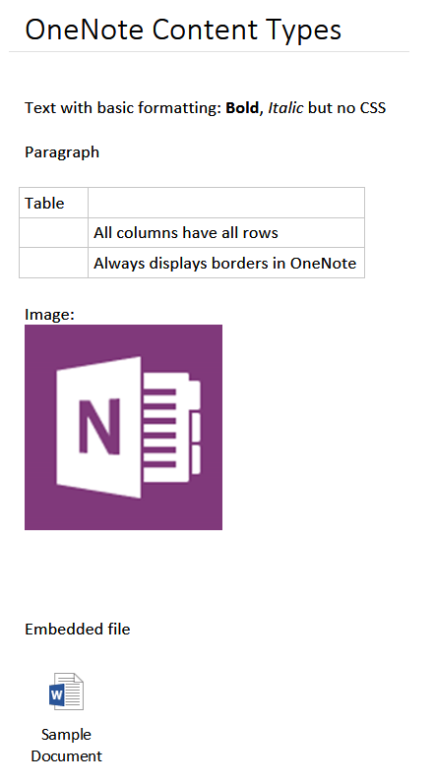
Capture Content
Text
Expressed as HTML
Only basic formatting: Bold, Italic, Paragraph, Table
Image
Embedded File
Notes:
Step 3: Capture the content

Slide 20
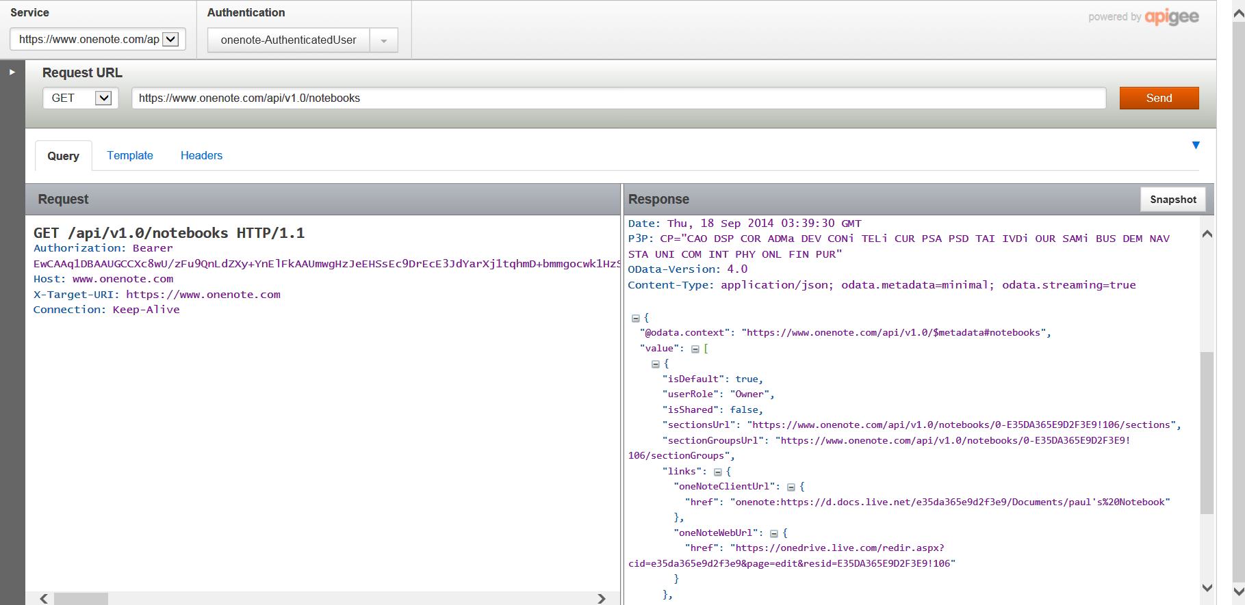
Add to OneNote
RESTful API
OAuth token in header
Content in POST body
UTF-8 encoding
HTML must be well-formed
Try it out
https://apigee.com/onenote/embed/console/onenote/
Notes:
Step 4: Send content to OneNote

Slide 21
OneNote REST Interface
GET
Pages
Sections
SectionGroups
Notebooks
POST
Pages
Sections
Notebooks
No updates to existing pages
Root URI
https://www.onenote.com/api/v1.0/

Slide 22
Post Body – Multipart/form-data
Content-Type:multipart/form-data; boundary=MyAppPartBoundary --MyAppPartBoundary Content-Disposition:form-data; name="Presentation“ Content-type:text/html ... presentation part html data ... --MyAppPartBoundary Content-Disposition:form-data; name="imageBlock-1“ Content-type:image/jpeg ... image binary data ... --MyAppPartBoundary

Slide 23
demo
Explore the REST API using apigee
Notes:
https://apigee.com/onenote/embed/console/onenote/

Slide 24
Content Capture in Depth

Slide 25
The in-depth slides contain code snippets that are copied from the demo “OneNoteServiceCreatePagesSample”
Running the sample by clicking the “Step through create page code” button will launch the debugger where the same code can be shown.
The debugger approach is preferred, but the slides can be used if necessary (network outage, other issues).

Slide 26
Capture Text
var client = new HttpClient(); client.DefaultRequestHeaders.Accept.Add(new MediaTypeWithQualityHeaderValue("application/json")); client.DefaultRequestHeaders.Authorization = new AuthenticationHeaderValue("Bearer", _authClient.Session.AccessToken); string simpleHtml = "<html><head>" + "<title>A simple page created from basic HTML-formatted text on Windows 8</title>" + "<meta name=\"created\" content=\"" + DateTime.Now.ToString("o") + "\" /></head>" + "<body><p>This is a page that contains some simple <i>formatted</i> <b>text</b></p>" + "<p>Here is a <a href=\"http://www.microsoft.com\">link</a></p></body></html>"; var endPoint = new Uri("https://www.onenote.com/api/v1.0/pages"); var createMessage = new HttpRequestMessage(HttpMethod.Post, endPoint) { Content = new StringContent(simpleHtml, System.Text.Encoding.UTF8, "text/html") }; HttpResponseMessage response = await client.SendAsync(createMessage);
Notes:
This snippet represents a simple text capture.
In addition, it provides the basic structure that the following snippets will build upon:
Create an HttpClient
Set the Headers
Build the content for the to-be-created page
Post to the endpoint

Slide 27
Capture Image
var client = new HttpClient(); // [set Accept and Authorization headers as previous example] string simpleHtml = // [similar to previous example] "<img src=\"name:image1\" width=\"426\" height=\"68\" />" using (var imageContent = new StreamContent(await GetBinaryStream("assets\\Logo.jpg"))) { imageContent.Headers.ContentType = new MediaTypeHeaderValue("image/jpeg"); var endPoint = new Uri("https://www.onenote.com/api/v1.0/pages"); var createMessage = new HttpRequestMessage(HttpMethod.Post, endPoint) createMessage.Content = new MultipartFormDataContent { {new StringContent(simpleHtml, System.Text.Encoding.UTF8, "text/html"), "Presentation"}, {imageContent, "image1" } }; }; HttpResponseMessage response = await client.SendAsync(createMessage);
Notes:
Capturing an image requires MultipartFormDataContent. The “src” attribute of the<img> tag has a specific protocol and value.
The protocol “name:” indicates the image is contained in another part of the Form Data with the given name (“image1” in this example).
Point out the names of the content in the MultipartFormDataContent. The string content (the html) is named “Presentation” and the image bytes are named the same as the value in the src attribute of the <img> tag.
The name “Presentation” is required – indicates the main part of the capture.

Slide 28
Capture Web Page Snapshot
var client = new HttpClient(); // [set Accept and Authorization headers as previous example] string simpleHtml = // [similar to previous example] "<img data-render-src=\"http://www.onenote.com\" />" var endPoint = new Uri("https://www.onenote.com/api/v1.0/pages"); var createMessage = new HttpRequestMessage(HttpMethod.Post, endPoint) { Content = new StringContent(simpleHtml, System.Text.Encoding.UTF8, "text/html") }; HttpResponseMessage response = await client.SendAsync(createMessage);
Notes:
This example is capturing a web page at URL specified in the data-render-src attribute.

Slide 29
Capture Web Page Snapshot
<img data-render-src="http://.onenote.com" ... />
The URL can be either a web page or an image
Must be publicly available without a password.
<img data-render-src="name:MultiPartBlockName" ... />
The content-type of that named block controls the API handling of content.
A block of HTML to render in a browser (content-type=text/html)
An image (content-type=image/jpeg or similar).
The HTML rendering engine used to create the image has no ability to log in a user, and does not include plug-ins (Adobe Flash, Apple QuickTime, etc.).
Dynamically-loaded content, (AJAX), won't appear credentials or cookies are required.
Notes:
The first method is great for archiving things you see on web sites that change frequently.
The second method is useful when the web page is more-complex than the OneNote page can faithfully render, or when the page requires login credentials. It is important to know that the HTML in the non-presentation block cannot use the data-render-src attribute.

Slide 30
Capture Web Page Snapshot
Complex HTML
Use data-render-src instead of attempting to modify the HTML to omit unsupported tags
Directly-editable text
Rendered images are scanned by an optical character recognition (OCR).
Best results by inserting the HTML directly onto the page.
Marking-up a web page design
Capture image via data-render-src
Use OneNote's inking capabilities to mark-up image.
Notes:
Some pointers for determine which approach to use when capturing a page.
If the page has complex HTML, then perhaps just let OneNote capture instead of trying to parse the HTML yourself
If you *must* have editable text, then you will need to send html instead of a URL

Slide 31
Capture Embedded File
var client = new HttpClient();// [set Accept and Authorization headers as previous example] string simpleHtml = // [similar to previous example] "<object data=\"name:file1\" data-attachment=\"file1.docx\" type=\"application/vnd.openxmlformats-officedocument.wordprocessingml.document\" />" using (var fileContent = new StreamContent(await GetBinaryStream("assets\\file1.docx"))) { fileContent.Headers.ContentType = new MediaTypeHeaderValue( "application/vnd.openxmlformats-officedocument.wordprocessingml.document"); var endPoint = new Uri("https://www.onenote.com/api/v1.0/pages"); var createMessage = new HttpRequestMessage(HttpMethod.Post, endPoint) createMessage.Content = new MultipartFormDataContent { {new StringContent(simpleHtml, System.Text.Encoding.UTF8, "text/html"), "Presentation"}, {fileContent, "file1" } }; }; HttpResponseMessage response = await client.SendAsync(createMessage);
Notes:
The <object> tag in the “Presentation” html will embed the file and show an icon.
The available media types: http://blogs.msdn.com/b/vsofficedeveloper/archive/2008/05/08/office-2007-open-xml-mime-types.aspx
docx == application/vnd.openxmlformats-officedocument.wordprocessingml.document
xlsx == application/vnd.openxmlformats-officedocument.spreadsheetml.sheet
pptx == application/vnd.openxmlformats-officedocument.presentationml.presentation

Slide 32
Capture PDF
var client = new HttpClient();// [set Accept and Authorization headers as previous example] string simpleHtml = // [include both <object> and <img>] "<object data=\"name:pdf\" data-attachment=\"file1.pdf\" type=\"application/pdf\" />“ "<img src=\"name:pdf\" />" using (var pdfContent = new StreamContent(await GetBinaryStream("assets\\file1.pdf"))) { fileContent.Headers.ContentType = new MediaTypeHeaderValue("application/pdf"); var endPoint = new Uri("https://www.onenote.com/api/v1.0/pages"); var createMessage = new HttpRequestMessage(HttpMethod.Post, endPoint) createMessage.Content = new MultipartFormDataContent { {new StringContent(simpleHtml, System.Text.Encoding.UTF8, "text/html"), "Presentation"}, {pdfContent, "pdf" } }; }; HttpResponseMessage response = await client.SendAsync(createMessage);
Notes:
As mentioned, the <object> tag will embed the pdf.
An <img> tag, when pointed to a StreamContent that represents a pdf will create an image for each page.

Slide 33
demo
Creating Content from Windows Store App
Notes:
Demos\OneNoteAPISampleWinStore folder:
Check authentication status in upper right. Click Authenticate if necessary. In the flyout, click Account
In left navigation, select a scenario.
In center, enter a section name. If it does not exist, it will be created.
Click the Create Page button to create the page. Review Response and link boxes.
** Do not click “Step through create page code” button at this time. **
After running a few scenarios, return to the slides to explain the steps.

Slide 34
Summary
Introduction
OneNote API Scenarios
Get Started with the OneNote service
Deep Dive into the OneNote service

Slide 35
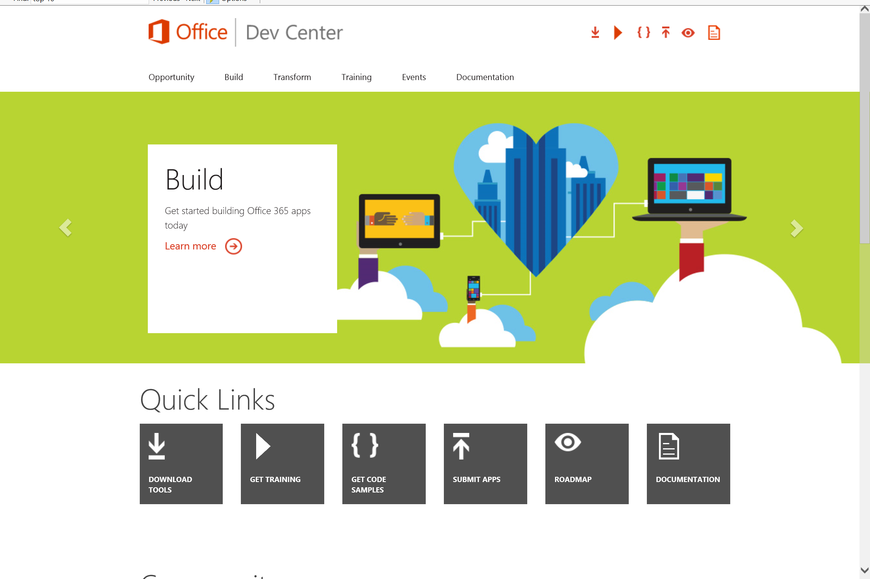
Dev.
Office
.com
One stop shop for Office Developer Platform

Slide 36
Calls to action
Explore our developer center
http://dev.office.com
Jumpstart into our training http://dev.office.com/training
Play with our code samples http://dev.office.com/code-samples
Get answers
http://aka.ms/AskSharePoint
http://aka.ms/AskOffice
Give feedback Drive our roadmap http://aka.ms/OfficeDevFeedback

Slide 37


Transform your code Providing App Model Patterns for common Full Trust Code scenarios
60+ Visual Studio projects Common scenarios
Branding
Site provisioning
Remote event receivers
Large file support
Taxonomy driven navigation
And much more…
Contribute
Open source coming soon!
Developer
Patterns & Practices
aka.ms/OfficeDevPnP

Slide 38
Microsoft Virtual Academy courses
2014
2015
Deep Dive into integrating Office 365 APIs with your mobile device development
Deep dive into the building blocks and services of the SharePoint platform
Deep Dive into integrating Office 365 APIs with your standalone web application development
Introduction to Office 365 Development
Deep Dive into the Office 365 App Model
Deep Dive into Office 365 Development on non-Microsoft Stack
Shipping your Office 365 App to the Office Store
Aug
Sept
Oct
Nov
Dec
Jan
Feb

Slide 39

© 2014 Microsoft Corporation. All rights reserved. Microsoft, Windows, and other product names are or may be registered trademarks and/or trademarks in the U.S. and/or other countries.
The information herein is for informational purposes only and represents the current view of Microsoft Corporation as of the date of this presentation. Because Microsoft must respond to changing market conditions, it should not be interpreted to be a commitment on the part of Microsoft, and Microsoft cannot guarantee the accuracy of any information provided after the date of this presentation. MICROSOFT MAKES NO WARRANTIES, EXPRESS, IMPLIED OR STATUTORY, AS TO THE INFORMATION IN THIS PRESENTATION.

